Slide 1
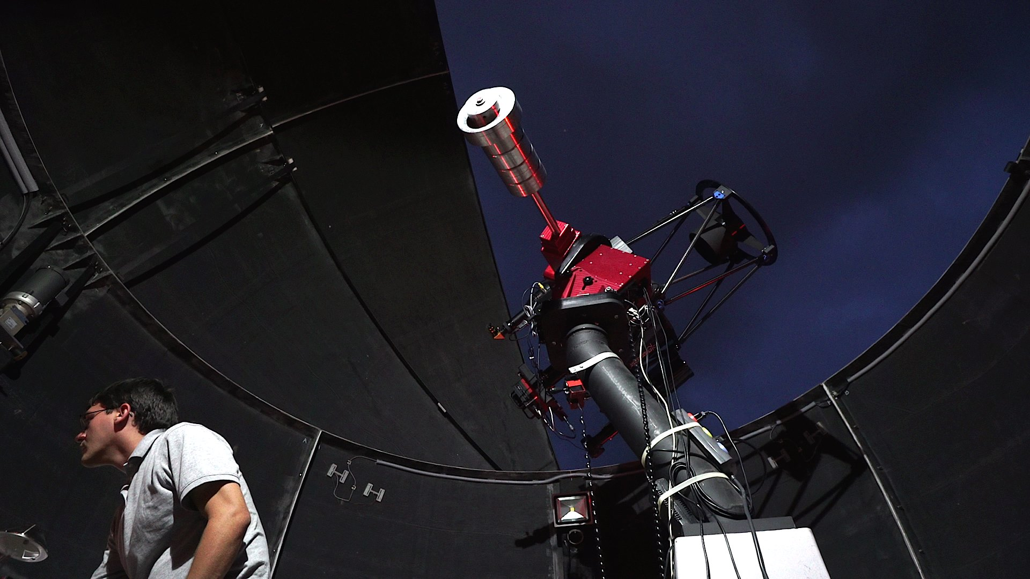
Image Analysis II

Slide 2
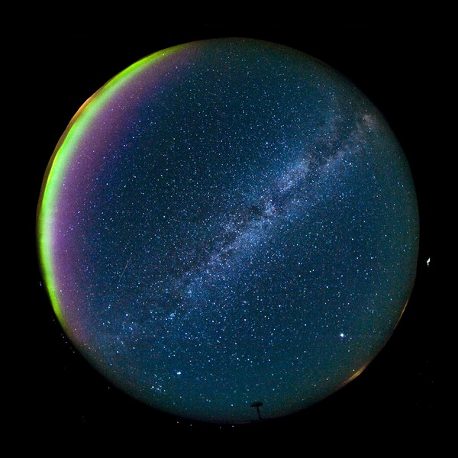
Which direction has the least amount of interference?
Toward the Horizon, facing South
Toward the Horizon, facing North
Facing East, away from the Sunset
Straight up toward the zenith

Slide 3
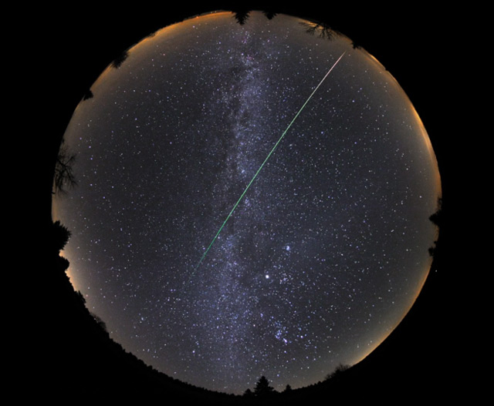
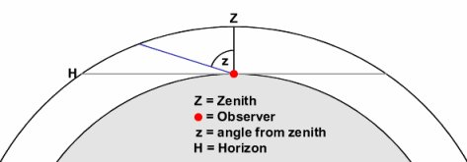
Which direction has the least amount of interference?
Toward the Horizon, facing South
Toward the Horizon, facing North
Facing East, away from the Sunset
Straight up toward the zenith

Slide 4
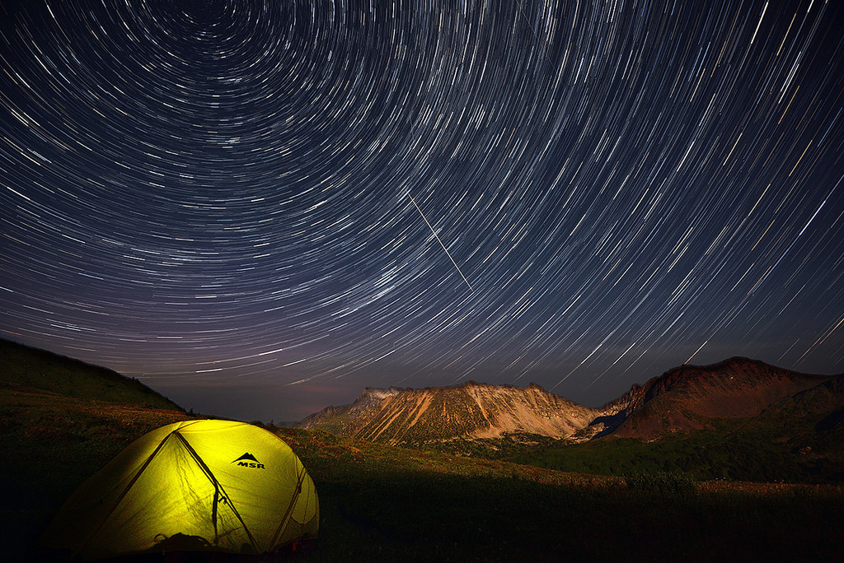
When will a given object be at its greatest altitude?
When it reaches the zenith
When it crosses the local meridian
When its right ascension is at 12^{h}
At midnight

Slide 5
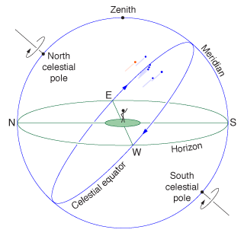
When will a given object be at its greatest altitude?
When it reaches the zenith
When it crosses the local meridian
When its right ascension is at 12^{h}
At midnight

Slide 6
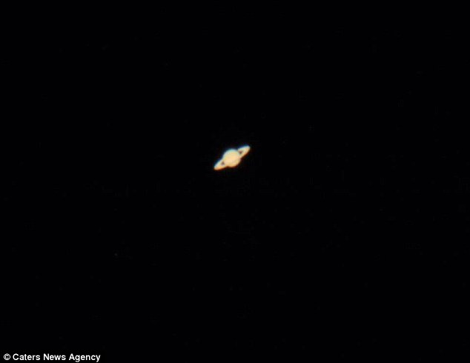
Why don’t planets have the same RA and Dec all year?

Slide 7
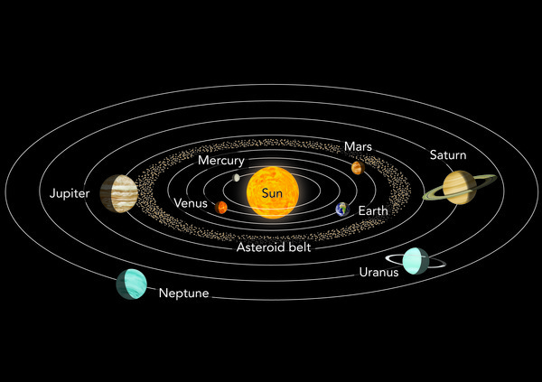
Why don’t planets have the same RA and Dec all year?
They revolve around the Sun

Slide 8
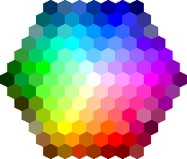
Order the following colors from longest to shortest wavelength:
Green
Red
Blue
Violet
Yellow

Slide 9
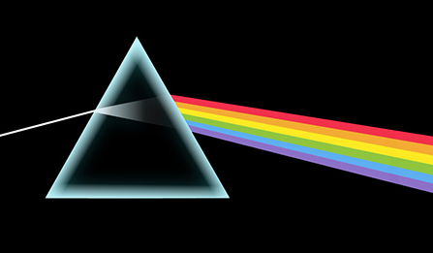
Order the following colors from longest to shortest wavelength:
Red
Yellow
Green
Blue
Violet

Slide 10
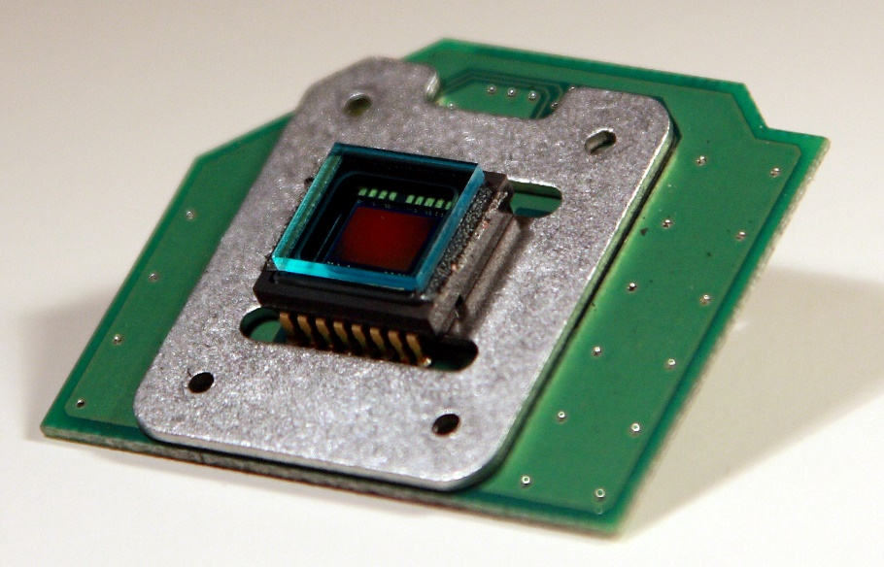
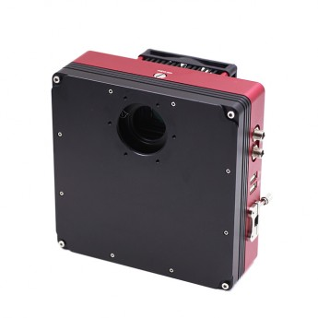
Charge-Coupled Device (CCD)
Large Quantum Efficiency
Captures >80% of incident light
Human eye ~1%
Linear Scale
Human eye = logarithmic
Long-Exposure Times

Slide 11
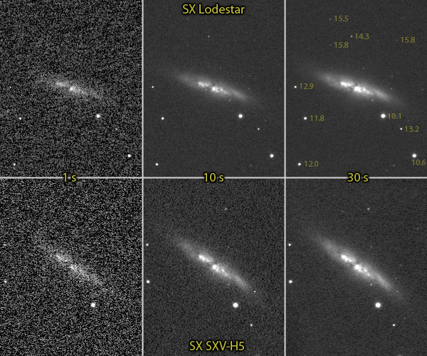
Exposure Times
Longer exposure
= more light
Faint Objects
~ minutes
e.g. Galaxies, Nebulae
Bright Objects
~ seconds
e.g. Star Cluster

Slide 12
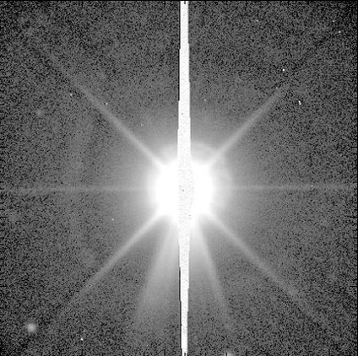
Exposure Times
Longer exposure
= more light
Faint Objects
~ minutes
e.g. Galaxies, Nebulae
Bright Objects
~ seconds
e.g. Star Cluster

Slide 13

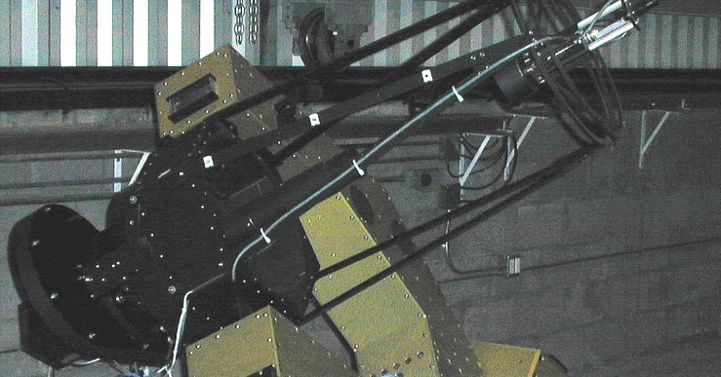
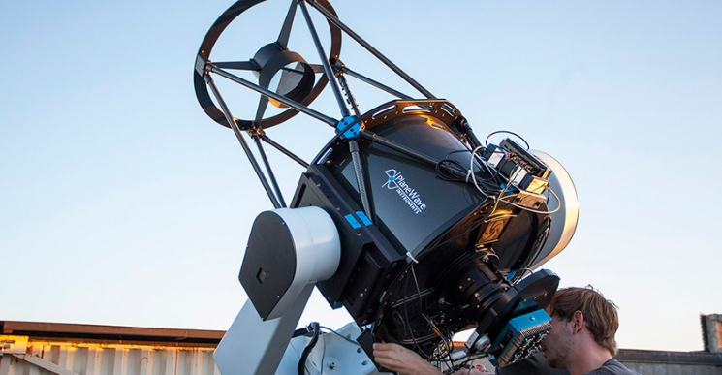
Iowa Robotic Observatory
VAO
Rigel
Gemini
17” Primary Mirror
14” Primary Mirror
(Replaced by Gemini)
20” Primary Mirror
(Sonoita, Arizona)

Slide 14
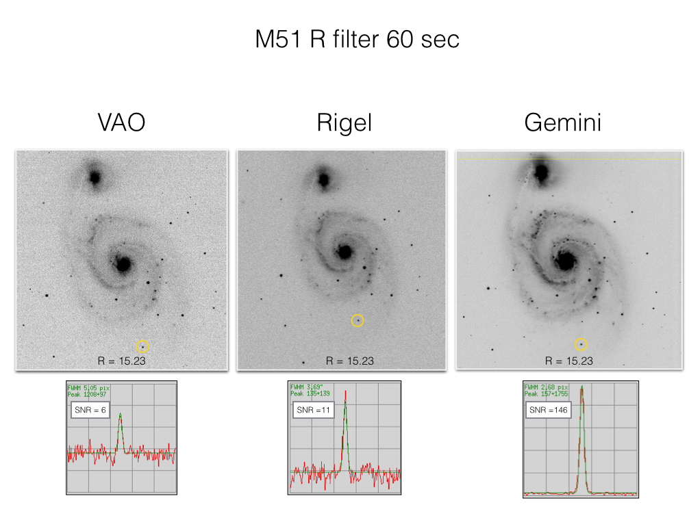

Slide 15
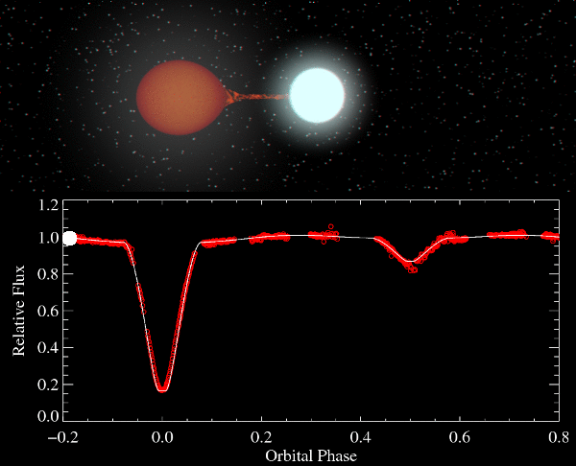
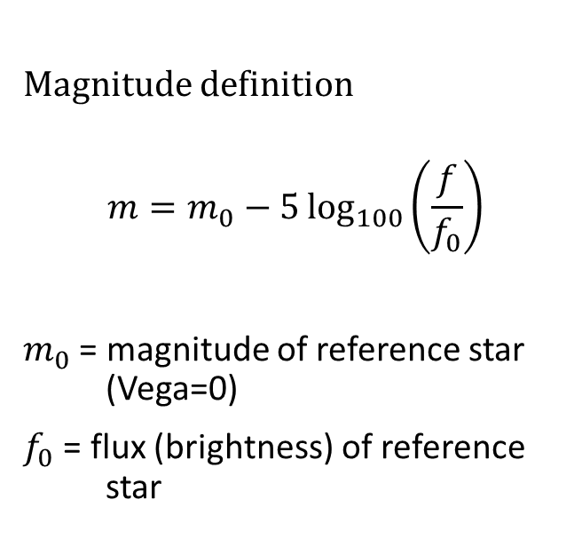
Eclipsing Binary
Magnitude definition
$$m=m_{0}−5\log_{100}\left(\frac{f}{f_{0}}\right)$$
$m_{0}$ = magnitude of reference star (Vega=0)
$f_{0}$ = flux (brightness) of reference star

Slide 16
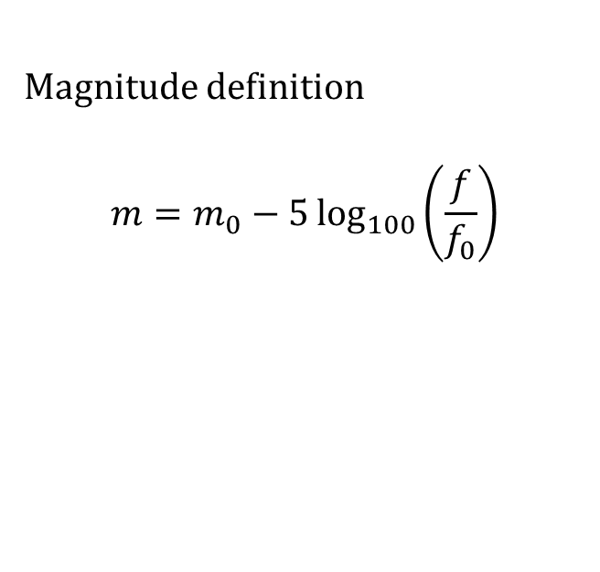
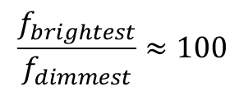
Eclipsing Binary
Magnitude definition
$$m=m_{0}−5\log_{100}\left(\frac{f}{f_{0}}\right)$$
Ptolemy’s System
1 = Brightest
6 = Faintest
$$\frac{f_{brightest}}{f_{dimmest}}≈100$$
Human eye uses
logarithmic scaling

Slide 17
